Slide 1

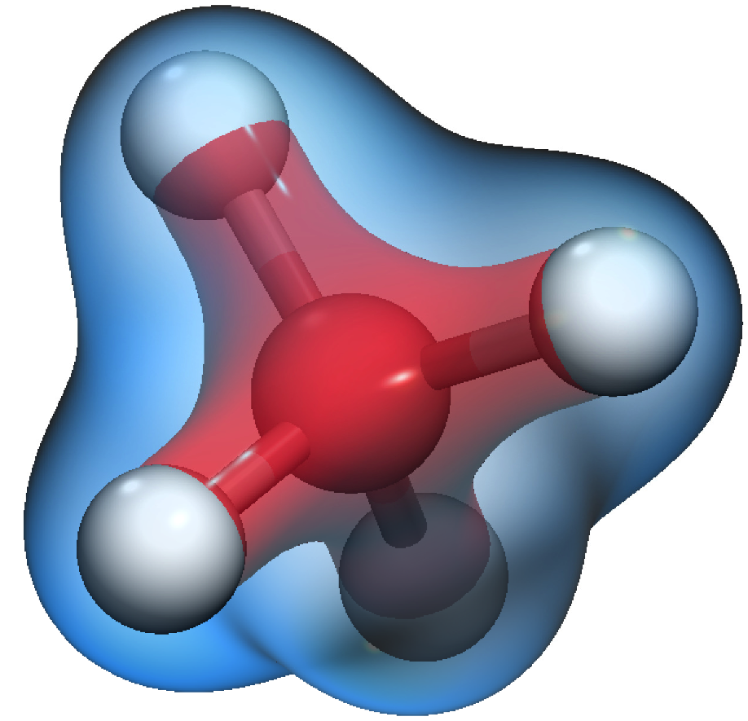
Kinetic Formalism for ab-initio Electronic Calculations
Miller Mendoza Jiménez
Collaborations: Hans J. Herrmann, Sauro Succi
Special Thanks to Tobias Kesselring
Notes:
/home/mmendozaj/ETH-design/presentation-openoffice/template_praesentation_oo.odp

Slide 2
Table of Contents
Motivation
Brief Introduction to Kohn-Sham Theory
Kinetic Theory and Kohn-Sham Boltzmann Equation
Applications
Exchange-Correlation of atoms
Methane Molecule
Hydrogen Oscillations
Summary
Model Description
Some applications

Slide 3
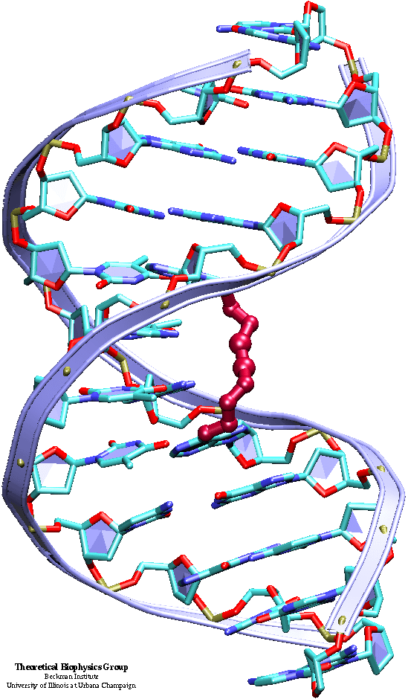
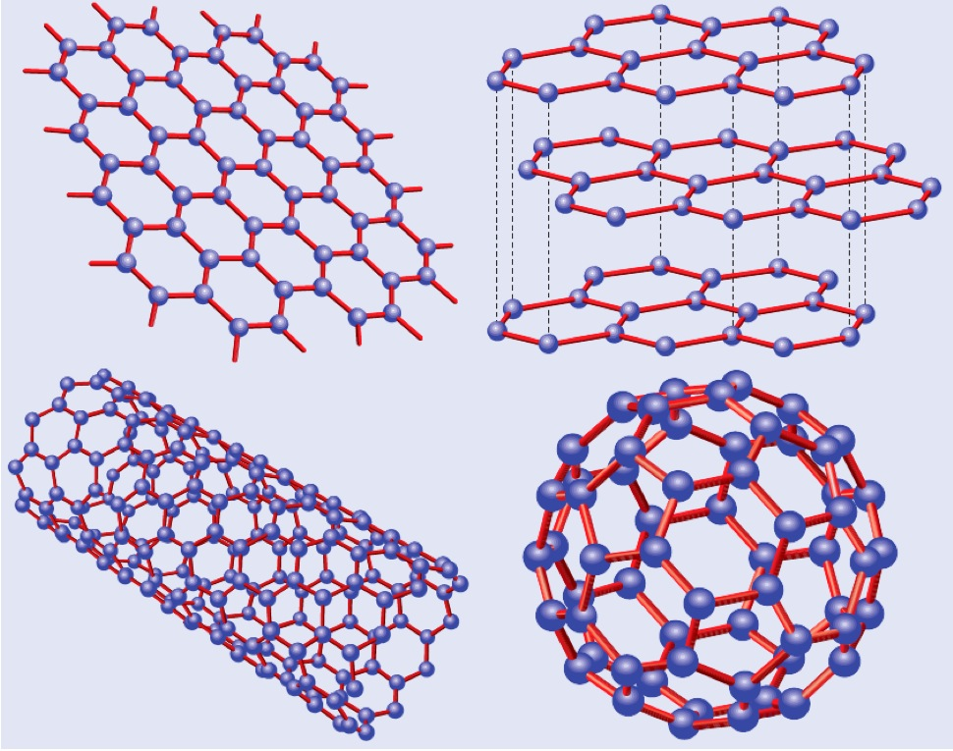
Some atomistic systems
Biology: DNA molecule
Chemistry: Methane molecule
^{J.} _{Appl.} ^{Phys. 64, 6365 (1988).}
Solid State Physics: Nanotubes and Graphene

Slide 4
Many-Body Electronic System
In a multi-electronic system with N electrons:
3N + N variables
Due to the Coulomb interactions, the system is not separable!
becoming extremely difficult to solve

Slide 5
Many-Body Electronic System
In a multi-electronic system with N electrons:
3N + N variables
However, in most of the cases, one needs only the total density of the system:

Slide 6
Kohn-Hohenberg Theorems (1964)
Kohn-Sham (1965)
Total energy is an unique functional of the electron density.
The density that minimizes the total energy is the exact ground state of the system.
The ground state of the system can be expressed as:
Time independent Schrödinger equation
Where the potential is
Exchange and correlation corrections.

Slide 7
Potential energy of the system:
Mean field approximation
Potential energy due to Ions and external sources
A. D. Becke, Phys. Rev. A 38, 3098 (1988).
C.Lee,W.Yang,andR.G.Parr,Phys.Rev.B37,785

Slide 8
Kinetic Theory: Classical Gas
Phase space
Velocity space
Spatial space
Boltzmann Equation
Number of particles

Slide 9
Kohn-Sham and Boltzmann Equations
Boltzmann Equation:
Kinetic Kohn-Sham Equations
?
Leads to:
Lead to:

Slide 10
Kohn-Sham as Diffusion Equation
Time-dependent Schrödinger equations:
Diffusivity
Wick rotation
Source term
Wave function and energy value of the ground state:
Energy
Ground state

Slide 11
Ground wave function as gas of virtual particles
Small Knudsen number
Linear approximation BGK
Relaxation time
??

Slide 12
Using Hermite Polynomials. For Simplicity
In general, one can write:
Weight function
Projection coefficients

Slide 13
Equilibrium distribution and Source Term
We do not know the expression, but we do not need one. The requirements for the equilibrium distribution and source term:
Our first guess!

Slide 14
The kinetic formalism:
The Kinetic Kohn-Sham equations:
Kohn-Sham orbitals and energies
Orthogonality conditions

Slide 15
Number of dimensions
Kohn-Sham equations: 3D
Kinetic Kohn-Sham equations: 6D
Is there any advantage?
YES!

Slide 16
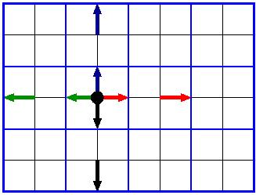
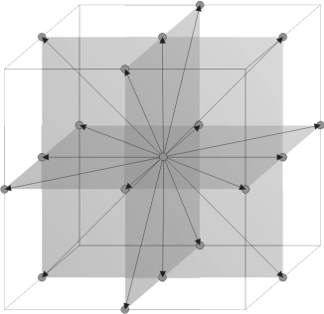
Lattice Boltzmann Method for Fluids
We do not need to discretize the whole velocity, but we can just choose a small number of representative vectors.
z
Collision:
Streaming:
y
x

Slide 17
Lattice Kinetic Kohn-Sham Model

Slide 18
Convergence to the Ground State

Slide 19
Exchange-Correlation energies

Slide 20
Carbon Orbitals and Methane Molecule
109.47°
1s²
2s²
2p²
Bond distance: 106 pm
Exp.: ~108 pm

Slide 21
Limitation:
Alternative Solution:
To increase the accuracy of the calculations we need to decrease the Knudsen numbers, which implies increasing the system size, and therefore, poor performance compared with traditional methods in DFT.
Keep the same Knudsen number, but imposing vanishing higher order moments.

Slide 22
Imposing Vanishing Higher Order Moments
For simplicity and to understand the idea, let us move to the one-dimensional case. One can proof from the stationary Boltzmann equation by consecutive integration:

Slide 23
Imposing Vanishing Higher Order Moments
For simplicity and to understand the idea, let us move to the one-dimensional case. One can proof from the stationary Boltzmann equation by consecutive integration:
For the discrete case, we can repeat the same procedure.

Slide 24
Some test for Poisson Equation
Using the lattice Boltzmann expansion and discretization procedure, we obtain, for instance up to 7th order:

Slide 25
Some test for Poisson Equation
Using the lattice Boltzmann expansion and discretization procedure, we obtain, for instance up to N = 7 order, and lattice size of L = 32 cells:

Slide 26
Some test for Poisson Equation
Using the lattice Boltzmann expansion and discretization procedure, we obtain, for instance up to 7th order:

Slide 27
Repeating the same for lattice kinetic KS, in 3D
For N = 5, we need 111 vectors
For N = 7, we need 385 vectors
Do we gain computational speed?
YES!

Slide 28
Comparison with the Previous Approach
BEFORE
NOW

Slide 29
Comparison with Standard Methods

Slide 30
Ab-initio Molecular Dynamics
Born-Oppenheimer (BO) Molecular Dynamics (Adiabatic Approximation)
Ions move, electrons find the ground state, ions move …
Concurrence Dynamics (CD):
Ions and electrons move at the same time. No relaxation to the ground state needed.

Slide 31
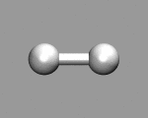
Hydrogen Molecule: First vibrational mode
LOSS OF TOTAL ENERGY IN THE SYSTEM !!

Slide 32
The problem: Non-reversibility of the BE
Presence of non-equilibrium terms in the distribution function.
Alternative solution, however, it needs more discussion:

Slide 33
Ab-initio Molecular Dynamics
CD is 17 times
faster than BO

Slide 34
Summary and Outlook
We have developed a new kinetic formalism for the Kohn-Sham equations. It can be more suitable to develop an equation for the total density, instead of solving the electronic orbitals.
A discretization of the velocity space in a small number of vectors makes the model competitive for solving many-body quantum systems.
Numerical results show very good performance and efficiency compared with other numerical methods.
Ab-initio molecular dynamics can be performed one order of magnitude faster using CD than BO.
Is it possible to derive the kinetic Kohn-Sham from the Kohn-Hohenberg theorem?

